Slide 1
Challenges in Communication
Department of Computer Science

Slide 2
Verbal Barriers
Inadequate knowledge or Vocabulary
Difference in Interpretation ( Denotation and Connotation)
Language Differences
Inappropriate Use of Expression
  Slang
  Jargon
  Euphemism
  Registers

Slide 3
Over Abstraction and Ambiguity
Polarization

Slide 4
Nonverbal Barriers
Inappropriate or Conflicting Signals
Differences in Perception
Inappropriate Emotions
Distractions

Slide 5
Physical Barriers
Hearing Disabilities
Weak Eye Sight

Slide 6
Psychological Barriers
Prejudice
Biasness
Stage Fright
Ego

Slide 7
Communicating in Diverse Environment
Recognize and Accept Diversity
Ethnocentrism
Cultural Differences

Slide 8
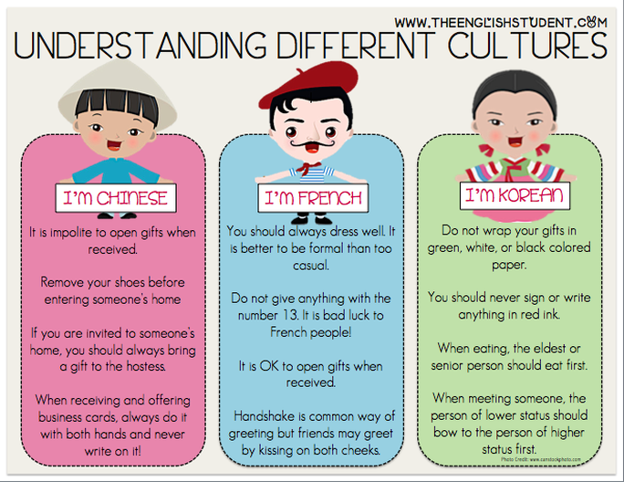

Slide 9
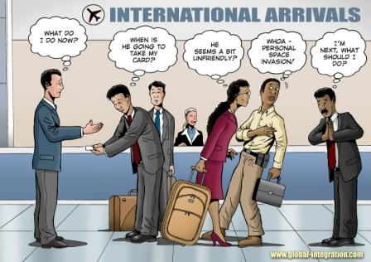

Slide 10
Cultural Differences
The language of time is as different as the language or words.
Variation in Body Language

Slide 11
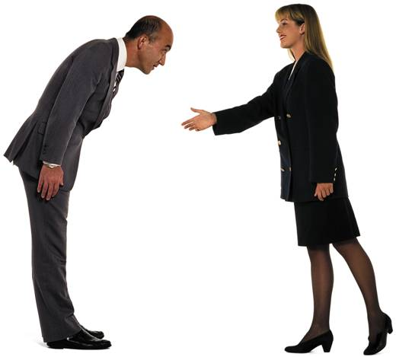
Continued…
Variation in Body Language

Slide 12
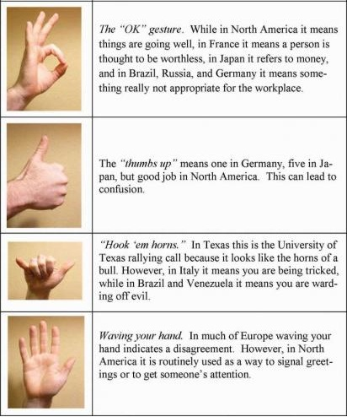

Slide 13
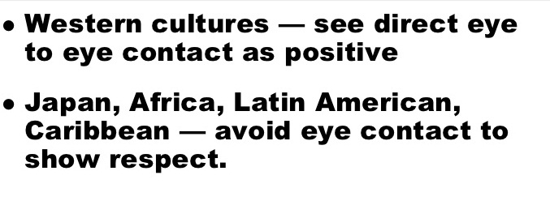

Slide 14
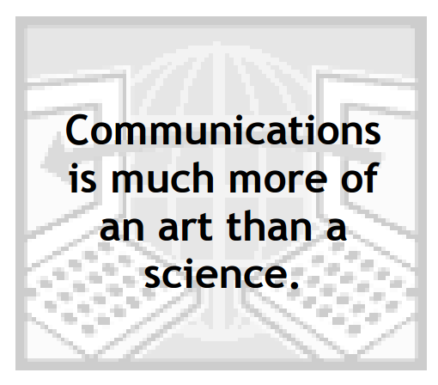
Activity No. 1

Slide 15
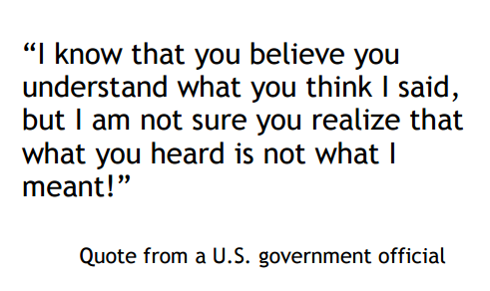
Activity No.2

Slide 16
Strategies for Communicating Across Cultures
Maintain Formality
Show Respect
Communicate Clearly
Value Diversity

